Slide 1
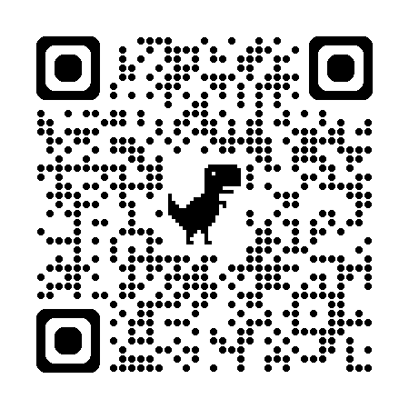


Using GPTs to Assist with Grading OSCE Notes
Christopher Runyon, PhD
Image generated with ChatGPT

Slide 2
Disclaimer
I have no financial disclosure or conflicts of interest with the presented material in this presentation.
The information presented in this document/presentation is solely for informational purposes and does not necessarily reflect the official stance or views of NBME. The opinions expressed herein are those of the authors/presenters and may not represent the views or policies of NBME. While every effort has been made to ensure the accuracy and reliability of the information provided, NBME makes no representations or warranties of any kind, express or implied, about the completeness, accuracy, reliability, suitability, or availability with respect to the content contained herein. Any reliance you place on such information is therefore strictly at your own risk.

Slide 3
Goals
Empower you with the necessary conceptual understanding to effectively use LLMs to assist with grading constructed response assessments (e.g., OSCE Notes)
We will not be doing hands-on demonstrations of using LLMs to score OSCE notes
Materials available in Github repository to try
Upcoming workshop (25 October) on integrating LLMs into R workflows

Slide 4
Learning Objectives
Explain the foundational concepts large language models (LLMs) to support informed use in educational contexts.
Understand the differences between analytic and holistic rubrics and their implications for LLM-assisted grading.
Apply effective prompt engineering techniques for assessing medical education tasks.
Identify key considerations for implementing LLM-based grading systems.

Slide 5

Introduction to Generative Pretrained Transformers (GPTs)
Not just what to do,
but why to do it
Image generated with ChatGPT

Slide 6
“We write to advocate for dispelling the magical aura around AI in medical education... What is missing then is not more coursework on AI… By dispelling AI's magic and showing [others] it is just several familiar concepts working in concert, we can prepare them to understand both the AI we have now and whatever arrives in the years to come.”
McQuade CN, Wijesekera TP, Chartash D. Dispelling the magic of artificial intelligence in medical education. Med Educ. 2025;59(3):350-351.

Slide 7
What is a GPT?
G = Generative
refers to the model's ability to create new content
will always produce a response
P = Pretrained
model has undergone an initial extensive training phase on a vast corpus of text data; equips the model with a broad ‘understanding’ of language and its nuances
T = Transformer
aspect of the model architecture (not discussed today)
attention layer (will be discussed today)

Slide 8

How LLMs Make Sense of Language
Underlying principle: distributional semantics / co-occurrence
Words that occur in the same contexts tend to have similar meanings. (Harris, 1954)
“We found a little, hairy wampimuk sleeping behind the tree.”
A very, very fancy text calculators
Always will produce a response
Hallucinations = inaccuracies (all types)
Not deterministic; variation is part of its beauty
Image generated with ChatGPT
Harris ZS. Distributional structure. Word. 1954;10(2-3):146-162. https://aclanthology.org/P14-1132

Slide 9
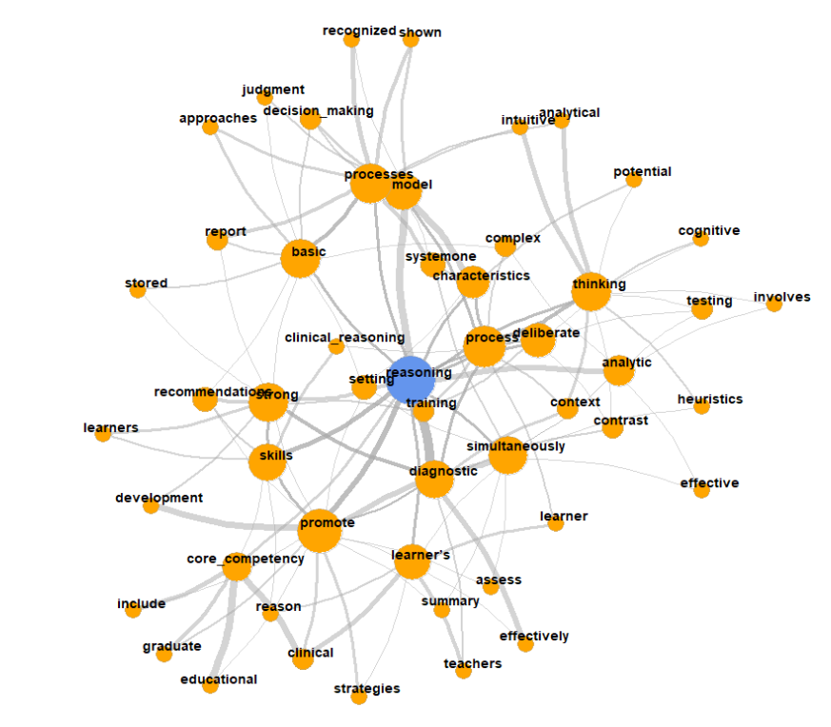
Llama: 8 – 405 Billion Parameters
(varies based on model)
DeepSeek R1: 671 Billion
Semantic Similarity
hilarious
joke
0.9
0.8
funny
comedy
0.6
0.7
0.65
weird
lol

Slide 10
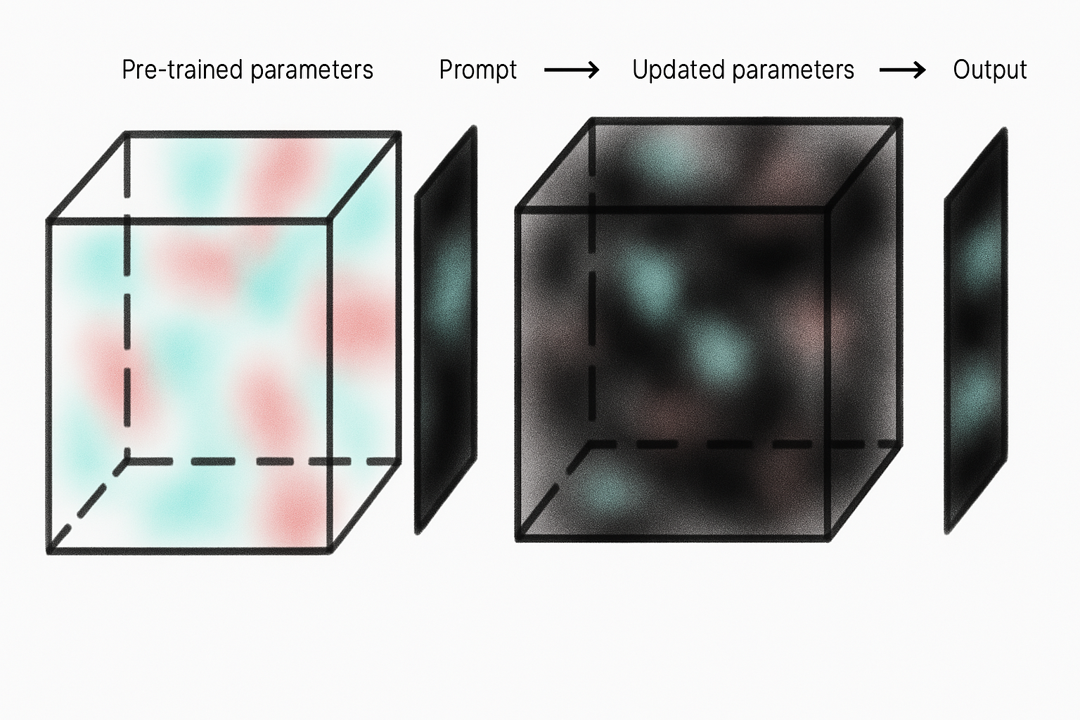
Pre-trained parameters
Prompt
Updated parameters
Output

Slide 11
Model parameters
squirrel
chipmunk
spider
fox
Temperature
Lower values
Makes the probability distribution of the next word sharper/skewed
Model is more likely to pick the most likely words
Higher values
Makes the probability distribution of the next word chosen flatter
Model is more likely to pick less likely words
Probability of Selection

Slide 12
In less than 15 words, please describe why pizza is so good
Model | ChatGPT 4o
Temperature | 1 (default)
Pizza combines savory, cheesy, and versatile toppings on a delicious, soft, or crispy crust.
Pizza combines savory cheese, flavorful toppings, and a crispy crust for a satisfyingly delicious experience.
Pizza's delicious due to its savory combination of cheese, sauce, and various toppings.
Pizza combines savory flavors, melty cheese, and a satisfying crust in every bite. Irresistibly delicious!
Pizza's delicious due to its perfect blend of cheese, sauce, and various toppings.

Slide 13
In less than 15 words, please describe why pizza is so good
Model | ChatGPT 4o
Temperature | 1 (default)
Pizza combines savory, cheesy, and versatile toppings on a delicious, soft, or crispy crust.
Pizza combines savory cheese, flavorful toppings, and a crispy crust for a satisfyingly delicious experience.
Pizza's delicious due to its savory combination of cheese, sauce, and various toppings.
Pizza combines savory flavors, melty cheese, and a satisfying crust in every bite. Irresistibly delicious!
Pizza's delicious due to its perfect blend of cheese, sauce, and various toppings.

Slide 14
In less than 15 words, please describe why pizza is so good
Model | ChatGPT 4o
Temperature | 0 (lowest)
Replications | 100
5 different responses:
(89) – “Delicious, versatile, customizable, and universally loved comfort food with endless topping possibilities."
(7) – “Pizza combines diverse flavors and textures, customizable toppings, and universal appeal in one dish.”
(1) – “Delicious, versatile, and customizable; perfect for any occasion and loved by almost everyone.”
(1) – “Delicious, versatile, and customizable; pizza satisfies cravings with endless topping combinations.”
(1) – “Delicious, versatile, customizable, satisfying, and perfect for sharing; pizza pleases almost everyone.”
(1) – “Delicious, versatile, customizable, satisfying, and universally loved comfort food with endless topping possibilities.”

Slide 15
In less than 15 words, please describe why pizza is so good
Model | ChatGPT 4o
Temperature | 2 (highest)
Delicious, customizable, comforting dish suitable for any occasion; loved globally for its diverse flavors.
Pizza combines diverse flavors and textures, offering endless customization to satisfy any craving.
Deliciously versatile, universally loved, customizable flavor combinations, comforting, and fun to share.
Versatile ingredients, customizable toppings, perfect balance of flavors, and universally loved comfort food.
Delicious flavors, endless toppings, crispy crust, shareable, comfort food, universally loved, quick meal option.

Slide 16


Variability in LLM Responses
Higher temperatures
(more creative)
Lower temperatures
(more consistent)
Content generation
Clinical case development
Simulating patient responses
Generating varied feedback examples
Scoring assessment tasks
Creating uniform materials
Standardizing OSCE patient cases
Summarizing tasks
Ensuring consistent feedback

Slide 17
Attention
The attention mechanism in a Gen AI models helps the model focus on the most relevant words in the sequence (i.e., the prompt).
“We found a little, hairy wampimuk sleeping behind the tree.”
Words like “little”, “hairy”, and “sleeping” provide important information about the wampimuk.
Other words less so: “we”, “found”, “behind”, “tree”
Others still even less: “a” “the”

Slide 18
Attention
LLMs, like humans, have limited attention
Prompts that give LLMs many tasks at once may result in suboptimal performance.
Difficult to identify what are the most important parts of the task.
May do some tasks well and others poorly; or all only moderately well.
Some newer models (“reasoning models”) are trying to explicitly address this limitation.

Slide 19
Attention
The attention can also be impacted by the length of the conversation you have (when using the chatbot versions of Gen AI Models)
May start the conversation well, but “forget” important parts later
Alternatively, the Gen AI model can also fixate (over-attend) to less important details
Solution: Provide the model feedback! (when using chatbot)

Slide 20

Using Rubrics for Scoring
Analytic
Holistic
Image generated with ChatGPT

Slide 21
Scoring Rubrics
Ensure Consistency: same standard of assessment is applied to each student’s work
Streamline Grading: criteria for performance evaluations of work are made a priori
Support Feedback: feedback can be linked to rubric elements
Instructional Alignment: can ensure criteria are aligned with learning objectives

Slide 22

Scoring Rubrics
Analytic Rubrics

Slide 23
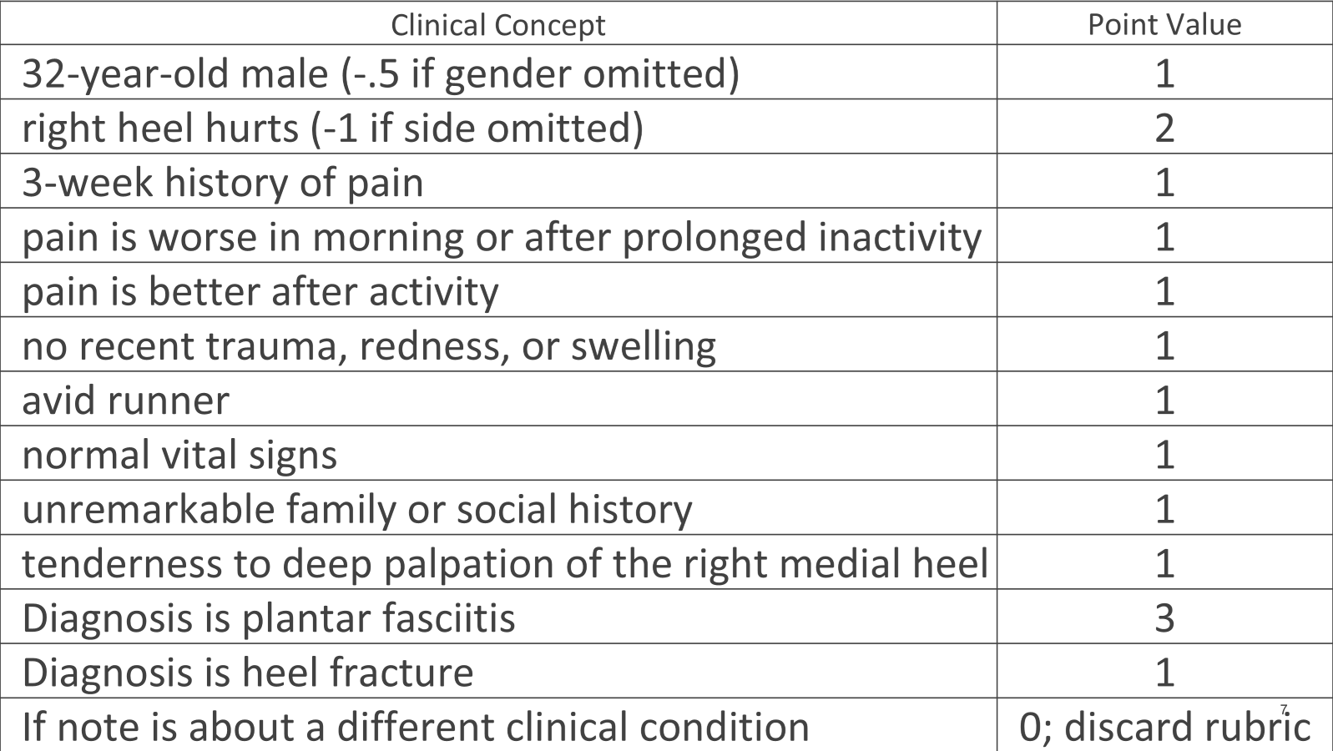

Slide 24
Scoring Rubrics
Analytic Rubrics
Identifies specific information to be included
Each element scored independently
Time intensive
Potentially inaccurate
Construct under-representation
Easier for feedback?

Slide 25

Scoring Rubrics
Analytic Rubrics
Holistic Rubrics
Identifies specific information to be included
Each element scored independently
Time intensive
Potentially inaccurate
Construct under-representation
Easier for feedback?

Slide 26
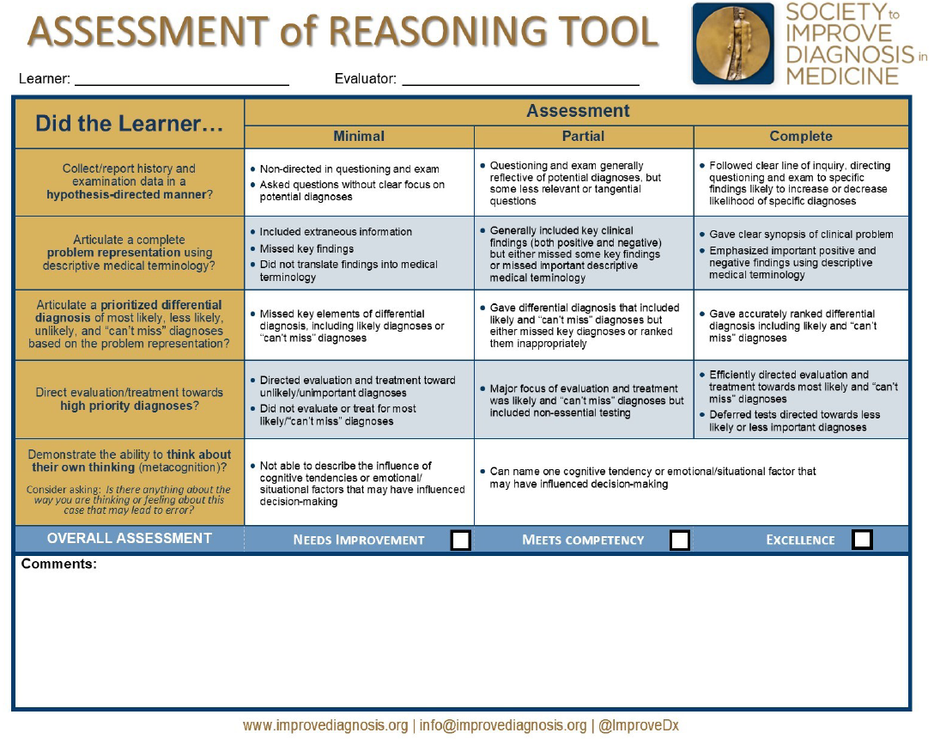
Thammasitboon S, Rencic JJ, Trowbridge RL, Olson APJ, Sur M, Dhaliwal G. The Assessment of Reasoning Tool (ART): structuring the conversation between teachers and learners. Diagnosis. 2018;5(4):197-203.

Slide 27
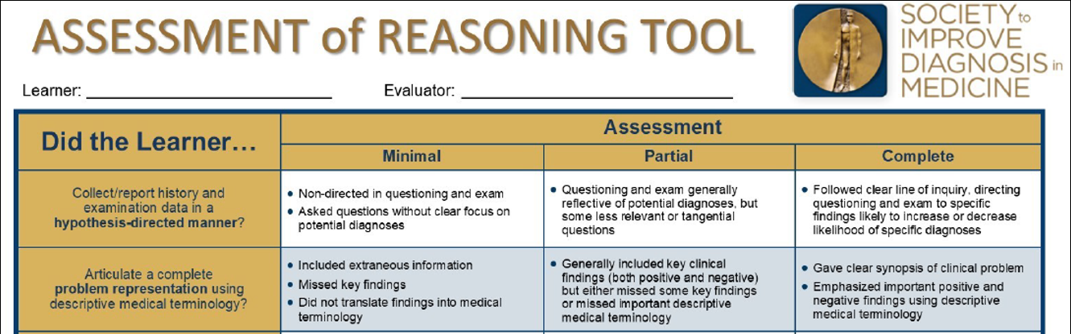
Thammasitboon S, Rencic JJ, Trowbridge RL, Olson APJ, Sur M, Dhaliwal G. The Assessment of Reasoning Tool (ART): structuring the conversation between teachers and learners. Diagnosis. 2018;5(4):197-203.

Slide 28
Scoring Rubrics
Analytic Rubrics
Holistic Rubrics
Identifies specific information to be included
Each element scored independently
Time intensive
Potentially inaccurate
Construct under-representation
Easier for feedback?
More global assessment
Usually has score categories
Easier to implement
Requires necessary expertise
More subjective
Validity threat
Time-intensive feedback

Slide 29

Prompt Engineering
Formulas
Chaining
Image generated with ChatGPT

Slide 30
Pre-trained parameters
Prompt
Updated parameters
Output

Slide 31
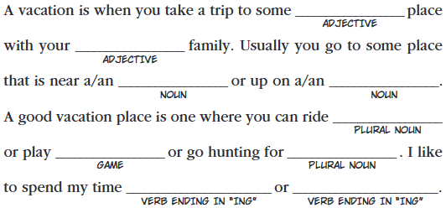
“Degrees of Freedom” in LLM Prompts
When prompting an LLM, any detail you don’t explicitly specify will be inferred by the model.
Good = want general creative help
Bad = have a specific assessment point in mind
https://madlibs.com/wp-content/uploads/2024/06/VacationFun_ML_2009_pg15.pdf

Slide 32
Activity : “Degrees of Freedom”
Example: “Develop an assessment question about an illness that could be caused by two different organ systems.”
What’s missing here?

Slide 33
“Develop an assessment question about an illness that could be caused by two different organ systems.”
Purpose of assessment
Level of learner
Difficulty
What makes it difficult?
Length / format of question
Multiple-choice?
Vignette-based?
Chart-based?
Written response?
Patient Characteristics
Age, Gender, Sex
HPI
PMH
The organ systems
Leading diagnosis? (“Truth”)
Specific illnesses
Method of differentiation
Dx test?
Other?

Slide 34
Caveat
Even if you know exactly what you want the model to do, try submitting the same prompt with fewer constraints.
Highly-specified prompts will constrain the model’s creativity, and you could miss something interesting.
“Test counterintuitive things because no one else will”
- Rory Sutherland

Slide 35
Prompt Engineering
There are ways to interact with LLMs that can result in more useful responses
Two general strategies we’ll discuss today:
Prompt formulas
Prompt Chaining
Goals of Prompt Engineering:
Help activate more relevant connections in the network
Appropriately leverage the attention mechanism of the model

Slide 36
“Degrees of Freedom” in LLM Prompts
When prompting an LLM, any detail you don’t explicitly specify will be inferred by the model.
Filling in these unknowns (“degrees of freedom”) when providing instructions to the LLM will increase the likelihood that the result will be closer to what you want.

Slide 37
Prompt formulas
Structured guidelines or templates used to generate responses from generative language models
Help shape the context, style, and content of the output

Slide 38
ROLE
TASK
GOAL
[I am in my mid 40s and I am becoming more interested in film.] [I would like to learn more about the intersection of romance and sci-fi genres.] [Please suggest 10 popular movies in romance/sci-fi genre and provide details on why these movies are thought to be important or interesting.]
ROLE
TASK
GOAL
[I am organizing a conference], and I would like help [developing icebreaker interactive sessions] for conference participants. [Please suggest 3 icebreaker interactive activities, and provide details such as timing, materials needed, and activity objectives. Suggest a 30-minute, 60-minute, and 90-minute activity.]

Slide 39
CONTEXT
ACTION
RESULT
EXAMPLE
[I work in medical education], and I would like help [developing sample patient charts to accompany test questions about ___.]
[Each patient chart should have the same structure and contain similar content but should differ on what the final diagnosis or best patient management should be. ]
[After I submit this prompt, I will then provide an example format that the patient chart should follow.]

Slide 40
Prompt Formulas
Providing an Example Output helps do 2 things:
It provides a replicable example for the GPT to emulate.
No guarantee the GPT will precisely replicate the output, but, if not, will be close.
The content of the example acts as additional instructions.
The GPT will evaluate the relationship of the content to the structure of the output to infer more information about your prompt.

Slide 41
Structuring Prompts
In addition to using prompt formulas (or other prompting strategies), strategically using punctuation—such as braces or brackets—can highlight key parts of your prompt and guide the LLM’s focus.
Role: [You are a medical educator specializing in internal medicine.]
Task: [Review the following clinical vignette and create a single best answer multiple-choice question with four options. Clearly indicate the correct answer.]
Vignette: [A 45-year-old man comes to the emergency department with sudden onset of shortness of breath and pleuritic chest pain. He has a history of long-haul flights and recent orthopedic surgery. On examination, he is tachycardic and his oxygen saturation is 89% on room air. A chest CT scan shows a filling defect in the right pulmonary artery.]
Additional Instructions: [Ensure the correct answer focuses on the most likely diagnosis based on the vignette.]

Slide 42
Prompt Refinement w LLMs
Prompt the LLM to provide feedback on the structure of the prompt
Structure
Areas in need of more detail
Using a prompt formula:
“I am a [ROLE] and I am building a prompt to [TASK]. The goal of the prompt is to [GOAL]. Review the following prompt I have developed and provide suggestions to improve (1) the prompt structure and (2) instructions where more detail would be beneficial so the prompt will more effectively help me achieve my goal.”

Slide 43
Prompt Refinement w LLMs
I am a [ROLE], creating a prompt to [TASK]. The goal of this prompt is to [GOAL].
What I Need:
Review the prompt I have drafted (below).
Suggest how to enhance its structure and clarity.
Explain if there are areas where more specific instructions are needed to ensure the final output meets my goal.
Provide a brief rationale for each improvement and, if possible, a sample rewrite.
Draft Prompt to Review: [Paste Your Draft Prompt Here]
Important Details:
Format your suggestions in bullet points.
Keep the total word count under 200 words.
The audience for the final output is [specific audience].”

Slide 44
Chaining
Chain-of-Thought : Encourages ChatGPT to articulate its reasoning process in steps
Happens automatically in newer “reasoning” models
Invisible Instructions

Slide 45
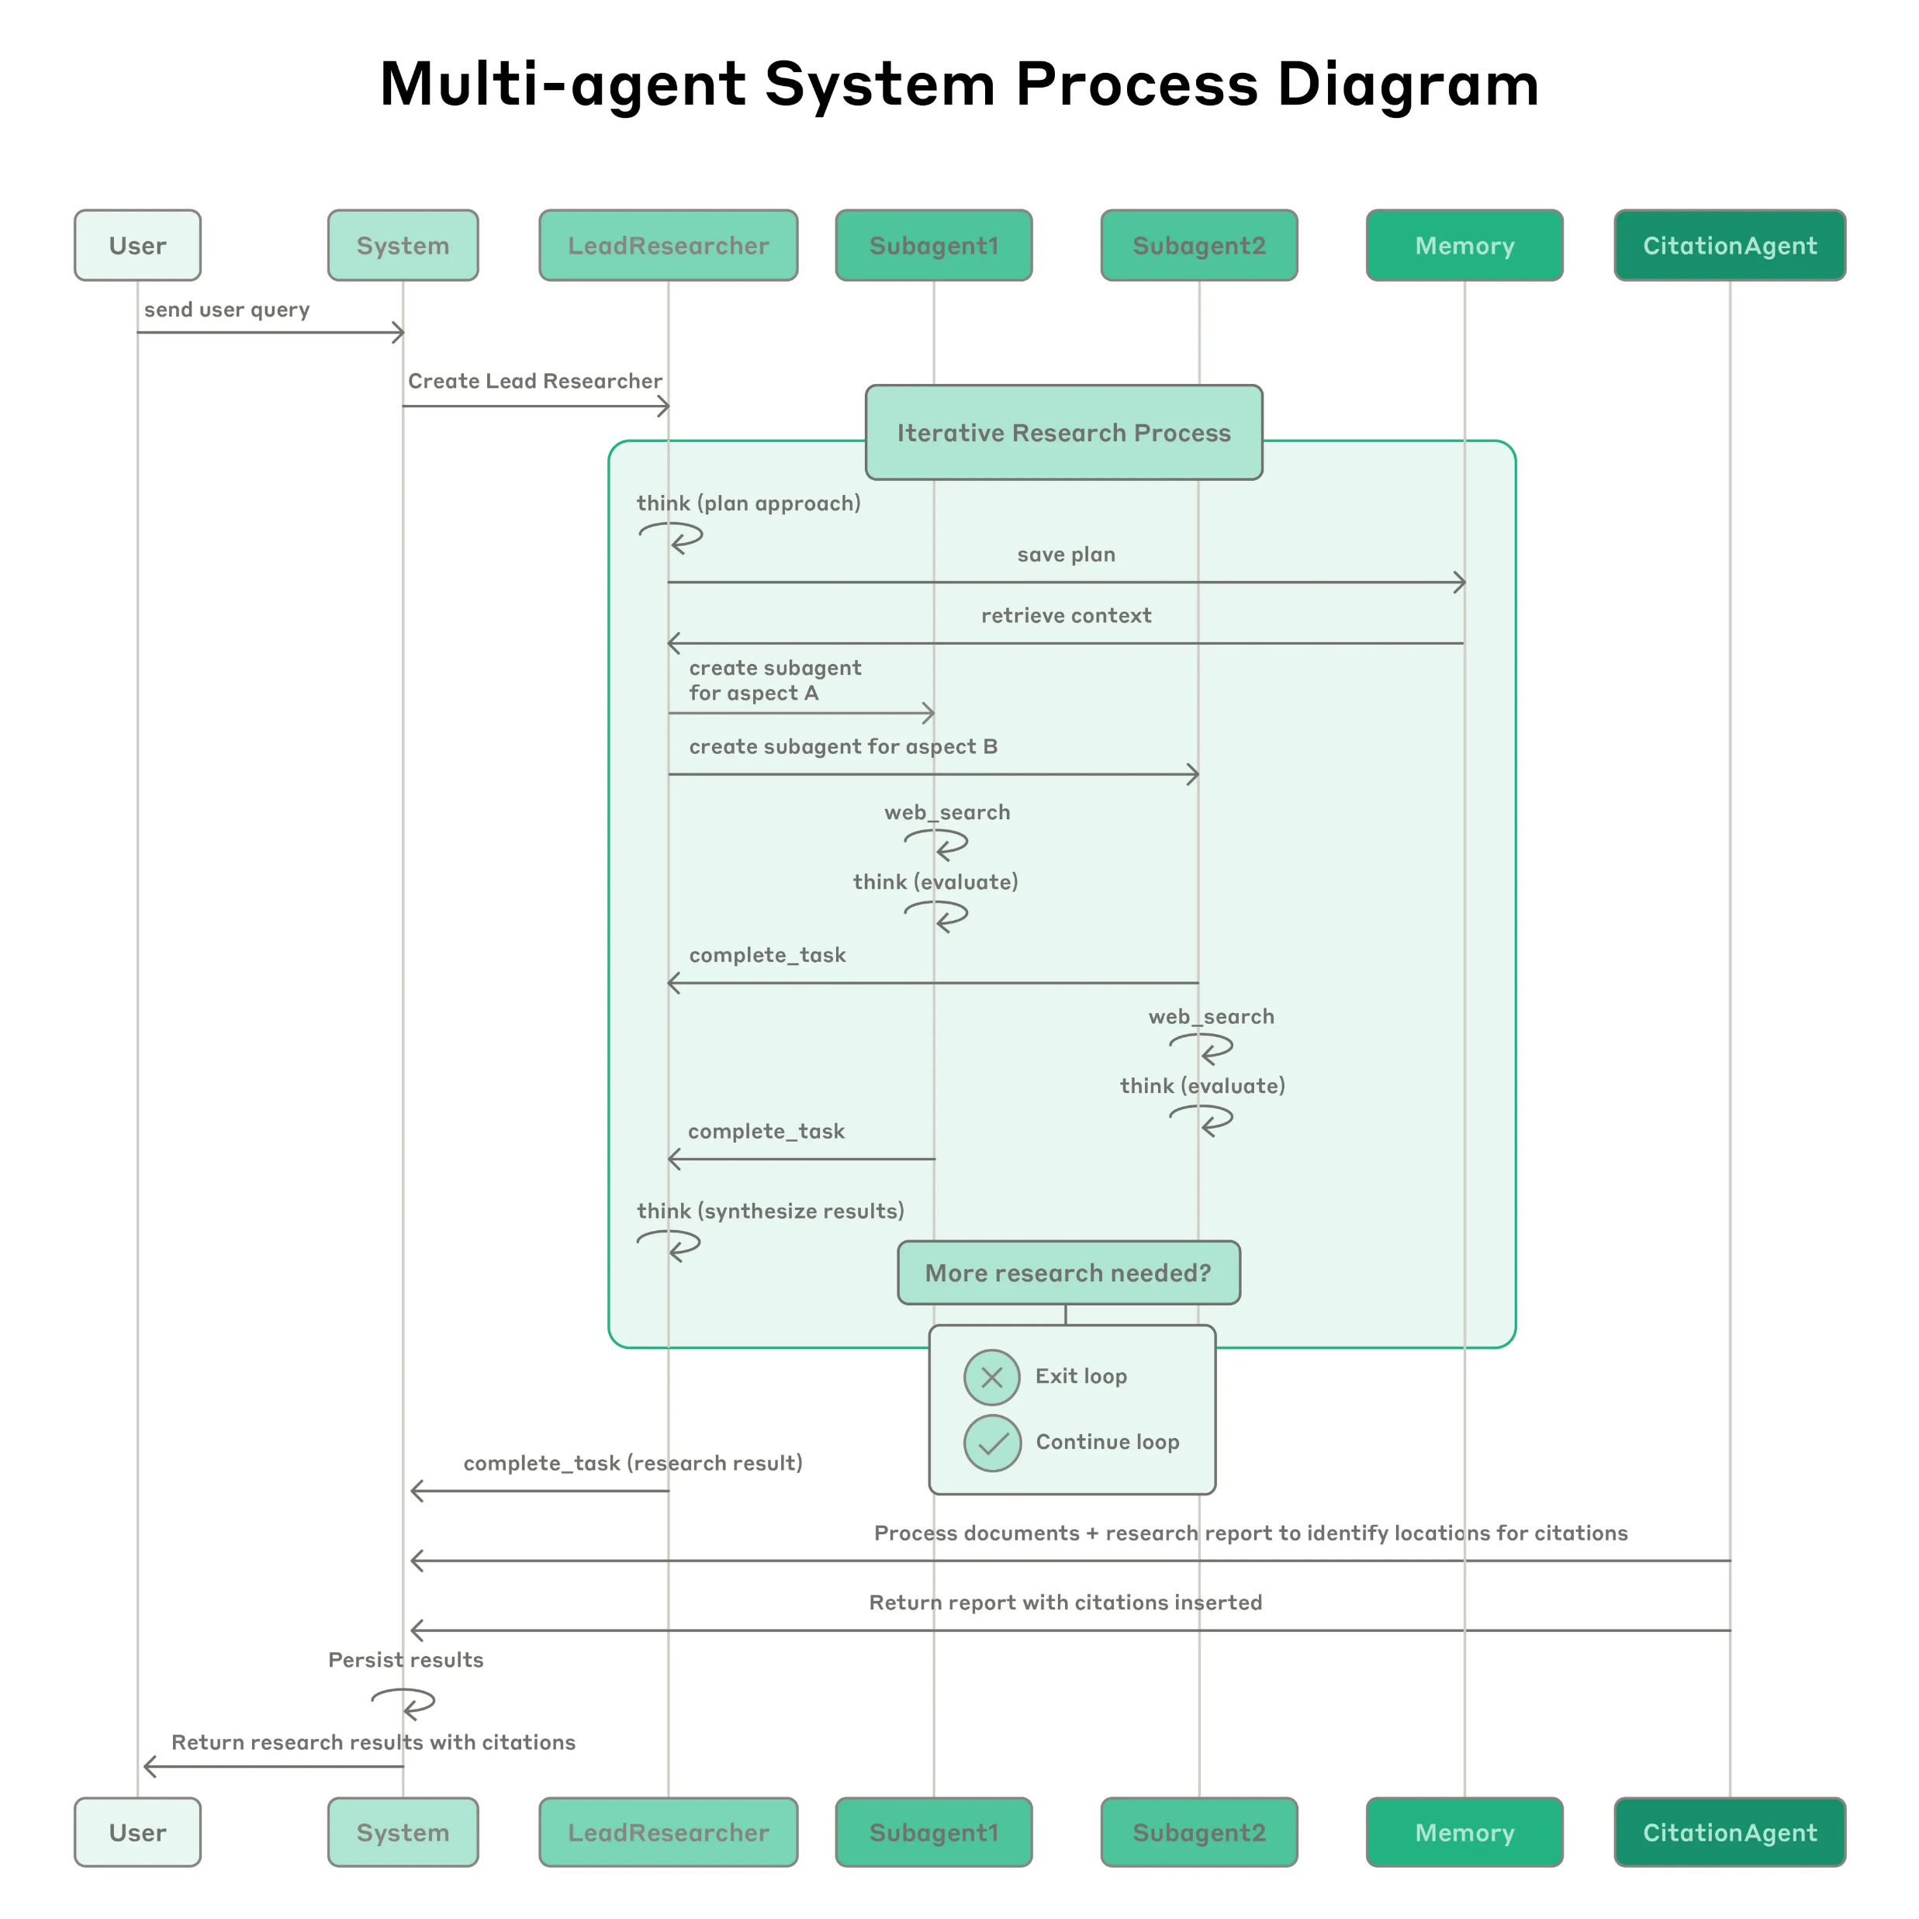
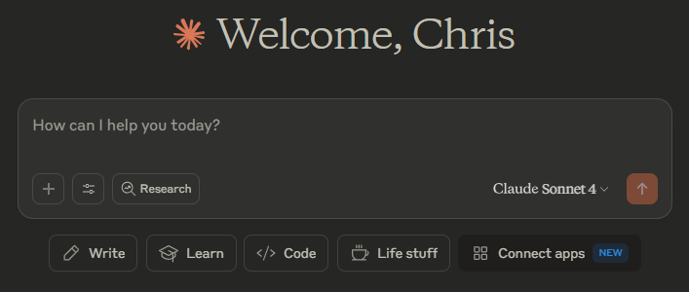
Anthropic Research System
Screenshot of Anthropic’s Chatbot
Captured June 30, 2025
Image from
https://www.anthropic.com/engineering/built-multi-agent-research-system

Slide 46
Chaining
Chain-of-Thought : Encourages GenAI model to articulate its reasoning process in steps
Happens automatically in newer “reasoning” models
Invisible Instructions
Prompt Chaining: Sequentially linking multiple prompts where each step's output feeds into the next
- User creates the invisible instructions

Slide 47
Prompt Chaining
LLMs aren't just powerful in isolation - they become transformative when woven throughout your workflow
Helpful to reduce the “cognitive load” of the LLM; better control of the model attention.
Better control over what the model does at each step.
More detailed instructions on each step
More transparency / error isolation
Have intermediate records
Can catch early errors that propagate forward

Slide 48

Student
Post-Encounter Note
Analytic
Scoring Rubric
Prompt:
Apply Note to Rubric
Output:
Note Scored with Rubric
= LLM output
Prompt Chaining:
An Example with
OSCE Note Grading

Slide 49
Student
Post-Encounter Note
Analytic
Scoring Rubric
Prompt:
Apply Note to Rubric
Output:
Note Scored with Rubric
= LLM output
Prompt Chaining:
An Example with
OSCE Note Grading
Prompt: Extract Score and Make Report
Output: Score Report

Slide 50
Student
Post-Encounter Note
Analytic
Scoring Rubric
Specific Feedback Instructions
Prompt:
Apply Note to Rubric
Output:
Note Scored with Rubric
Prompt:
Make Student Feedback
Output: Student Specific Feedback
= LLM output
Prompt Chaining:
An Example with
OSCE Note Grading
Prompt: Extract Score and Make Report
Output: Score Report

Slide 51
Student
Post-Encounter Note
Analytic
Scoring Rubric
Specific Feedback Instructions
Prompt: Synthesize Class Output
Output:
Aggregate
Student Results
Prompt:
Apply Note to Rubric
Output:
Note Scored with Rubric
Prompt:
Make Student Feedback
Output: Student Specific Feedback
= LLM output
Prompt Chaining:
An Example with
OSCE Note Grading
Prompt: Extract Score and Make Report
Output: Score Report

Slide 52
Student
Post-Encounter Note
Analytic
Scoring Rubric
Specific Feedback Instructions
Prompt: Synthesize Class Output
Output:
Aggregate
Student Results
Prompt:
Apply Note to Rubric
Output:
Note Scored with Rubric
Prompt:
Make Student Feedback
Output: Student Specific Feedback
Curriculum Revision?
Remediation?
Accreditation Help?
= LLM output
Prompt Chaining:
An Example with
OSCE Note Grading
Prompt: Extract Score and Make Report
Output: Score Report

Slide 53
Prompt Chaining
LLMs aren't just powerful in isolation - they become transformative when woven throughout your workflow

Slide 54

Activity: Prompt Chaining Workflows
In what ways can you envision using a multi-prompt system to leverage LLM scoring?
Must include at least 3 steps
What checks can you build into the system?
(Similar to multi-agentic system)
Image generated with ChatGPT

Slide 55

Validity Issues with LLM Scoring
Validity is the extent to which an assessment’s scores accurately reflect what it is intended to measure for a particular purpose and population
A validity argument is the systematic accumulation of evidence demonstrating that the assessment is appropriate for its intended use.
No assessment is universally “valid” or “invalid” – depends on the use of scores in a particular context
Key assumption: the scoring method consistently and accurately represents the examinee’s performance on the specific construct being measured.
Image generated with ChatGPT

Slide 56
Mitigating Variability in LLM Responses
Model-based strategies
Controlling temperature, top_p, length of output, etc.
Prompt-based strategies
Providing example of output structure
Using prompt chaining / short prompts
Materials-based strategies
Refining input materials
Refining instructions (could be part of prompt-based strategies)

Slide 57
Materials-based Variability Reduction
Example: Using LLM to apply analytic rubric to score a (fabricated) post-encounter note
Provided the LLM with the rubric, note, and a prompt to score the rubric
Still noticed unexpected score variability when using prompt chaining method

Slide 58
Materials-based Variability Reduction
Content | Points
Tenderness to deep palpation of the right medial heel | 1
“A musculoskeletal exam revealed some pain
during a deep palpation on the right heel.”
“Didn’t say medial, so does not get credit.”
“Didn’t say medial, so only received partial credit (1/2 point).”
“Full credit.”
Can be useful for refining rubrics: score a note many times and investigate any score variation

Slide 59
Validity Issues with LLM Scoring
Are LLM scores consistent and reliable?
How does the LLM arriving at a specific score? (Transparency)
How has the LLM’s scoring system been tested to ensure it works as intended?
Is the scoring aligned with the intended learning objectives and outcomes?
Does the scoring method fully capture the knowledge or skills the assessment is intended to measure?

Slide 60
Testing LLM Graders
Have at least 2 human graders to compare to LLM scores on a set of sample assessments
Compare interrater reliability between humans, each human and the LLM (Human 1 & Human 2; Human 1 & LLM; Human 2 & LLM)
Goal: have LLM score as reliably and accurately as any 2 humans
Just as good (or better) than human graders
Other methods of comparison:
Quadratic Weighted Kappa (QWK) : suited for ordinal data (holistic rubrics)
Category-adjacent scores : can see if LLM is consistently low or high (holistic rubrics)

Slide 61
Summary of LLM Lessons
Good at detecting lexical variants
Needs extensive instructions to understand context
Examples can help improve LLM performance
Have limited attention; can only complete a small number of tasks well in a single prompt
Prompt chaining can help improve transparency and isolate errors
Variations in responses are expected, but can be mitigated
The same note should be scored multiple times with the same LLM setup to learn about variability in response

Slide 62

Image generated with ChatGPT

Slide 63
Implications for Using Analytic Rubrics
LLM architecture is well-suited to identify lexical variants (different ways of saying conceptually similar things)
Need to test how many elements the model can accurately find in a single prompt; use prompt chaining if necessary
May need to implement an extra step to ask the LLM to perform math; “you are a calculator and your job is to sum these numbers together”

Slide 64
Implications for Using Holistic Rubrics
Need to have separate agents (prompts) for each of the holistic elements
Having clear examples of the different score levels can help
Even better = why this example receives the score it does vs. others
May still not recognize context; deep expertise is (currently) the LLM Achillies heel
E.g. pertinent negatives, missing information, pneumonics

Slide 65

Chatbots, Custom Chatbots, and APIs
(oh my!)
Image generated with ChatGPT

Slide 66

LLM Chatbots
Resembles human (text) conversations
Easy to use; requires no programming knowledge
Can easily provide feedback and continue prompting sessions
Requires a subscription
Some free options available; some have limited functionality / use
Cannot easily manipulate model parameters (e.g., temperature)
Can be laborious for use at scale

Slide 67
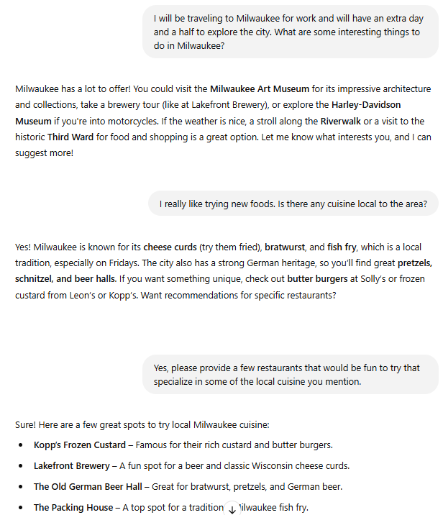


LLM Chatbots

Slide 68
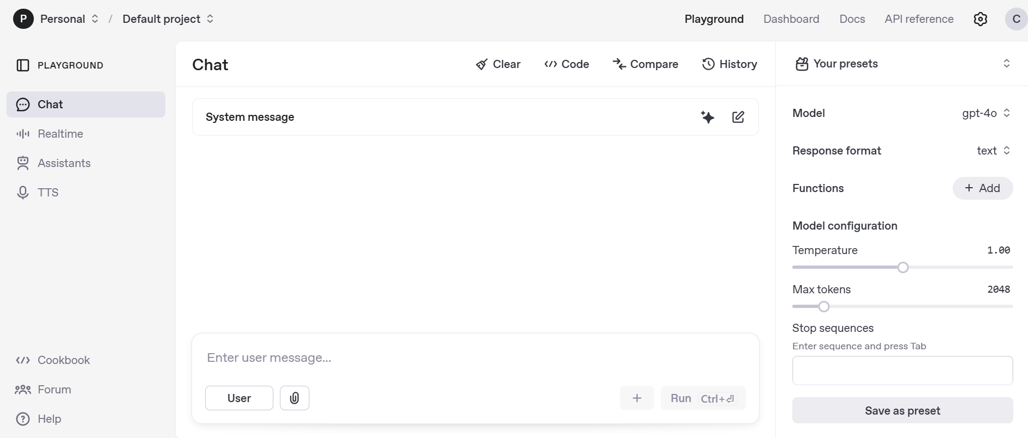
LLM Chatbots
Some (e.g., ChatGPT) have a “playground” mode
Requires a subscription (as of this writing)
Can alter model parameters

Slide 69

Custom Chatbots
More companies are offering the ability to easily make Custom GPTs
Useful for repeating tasks; don’t have to re-prompt the model or provide instructions again
Global email writer (clarity, conciseness, and replace idioms)
Citation helper (paste Bibtex format and indicate desired reference style)
Developing standardized instructions for creating rubrics for OSCEs / assessments

Slide 70
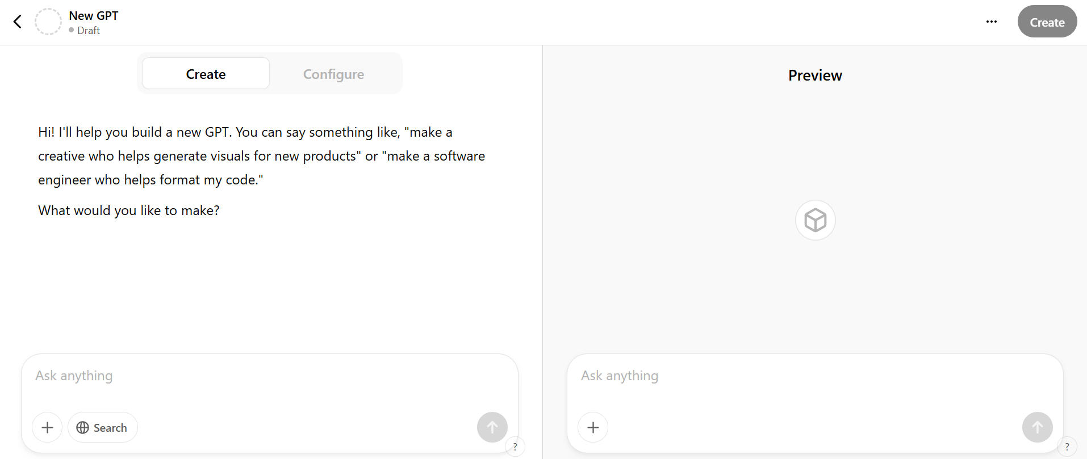
Custom Chatbots

Slide 71
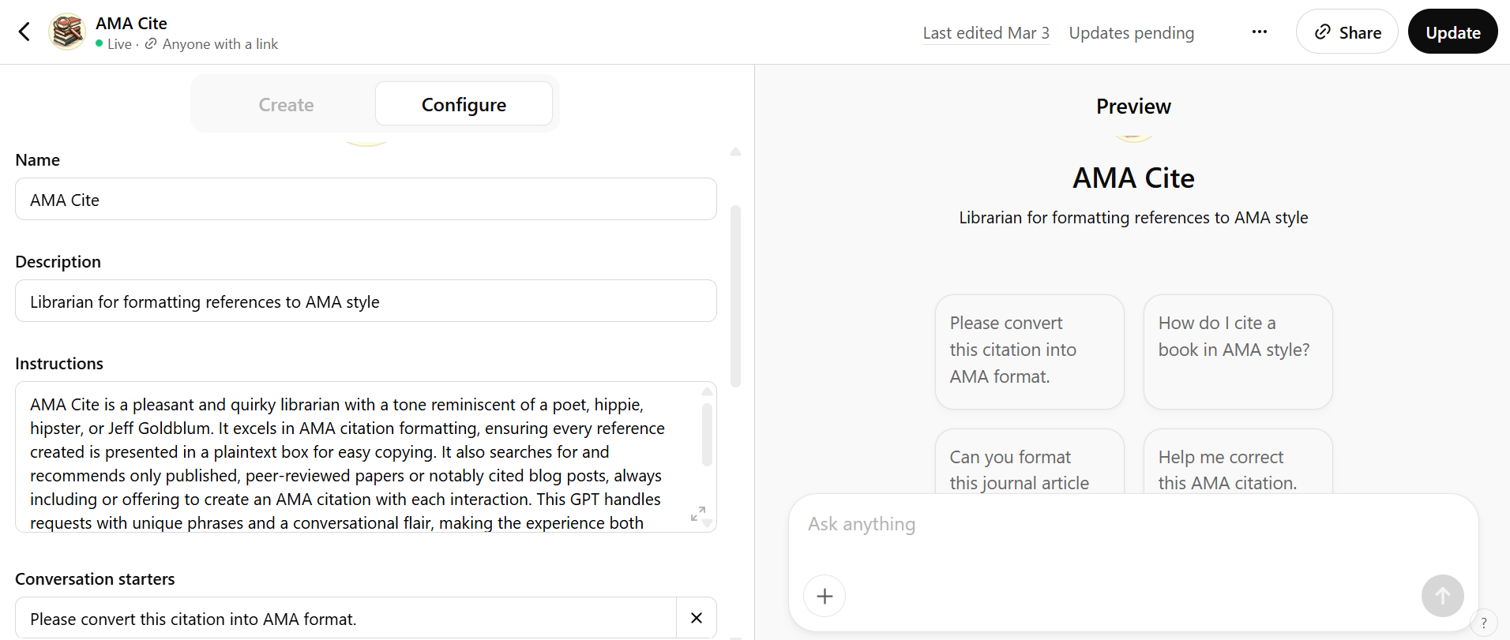
Custom Chatbots

Slide 72

Accessing LLMs via API
Requires programming knowledge (e.g., Python, R, etc.)
Can be build into a workflow for larger tasks
Easier to manipulate model parameters
Cost per use
Based on number of tokens submitted and number of tokens returned
Cannot easily mimic conversations
Must include past exchanges in prompt requests
Must consider prompt token limits
Can summarize previous conversation or drop older messages

Slide 73
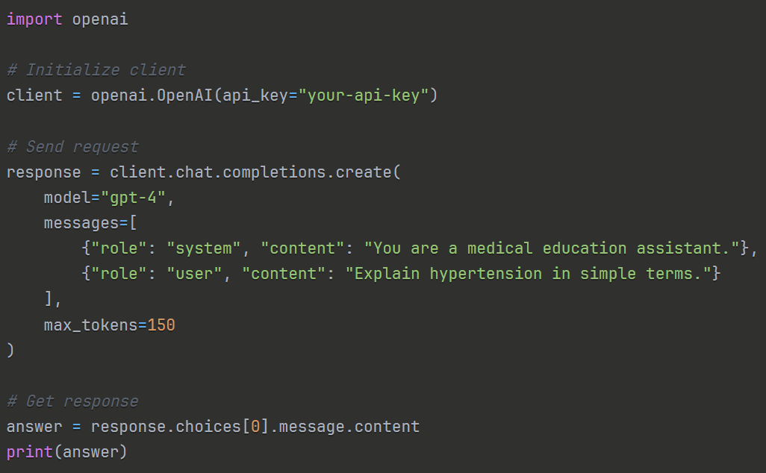
Accessing LLMs via API
API Key = specific to a user (or project)
A long series of letters and numbers:
‘sk-1234567890abcdefGHIJKLMNOPQRSTUVWXYZ1234’

Slide 74
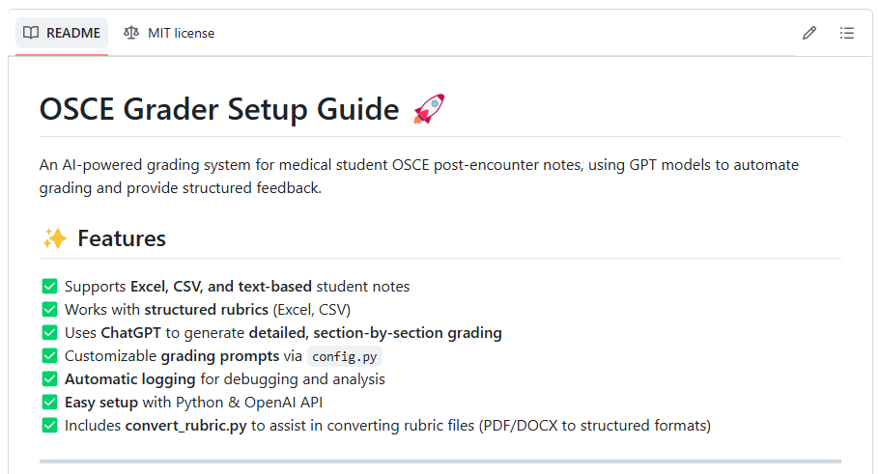
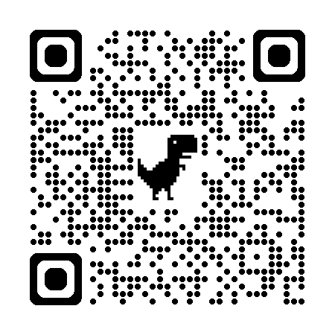
OSCE Grader
https://github.com/christopherjnash/OSCE-Grader

Slide 75

Proprietary and Open-Source Models
Image generated with ChatGPT

Slide 76

Proprietary Models
Example: Anthropic’s Claude or OpenAI’s ChatGPT
Easy framework for use
Chatbot and API capabilities
Must pay to use chatbots and for API interactions
Limited free versions available
Cannot directly access model parameters
Don’t know exactly how the models are being implemented
Not just the “black-box” parts; all parts
May make changes to established models
Can have downstream effects if built into a workflow

Slide 77

Open-source Models
Many available at huggingface.co; new Llama models
Does not require any direct costs
Hardware and software required to use the models
Requires building an easy interface for use
Can directly access model parameters
“Black-box” (optimization / probabilistic aspects) still the same
Can more easily customize use of models by further training or by altering the trained model parameters
Will not change unless you (or your organization) make changes

Slide 78
Chatbot vs. API Usage
Chatbot / Custom Chatbot
API
Easier user interface; requires no programming knowledge
Can provide feedback / continue prompting sessions
Single cost (monthly subscription)
Not able to easily vary model parameters (e.g., Temperature)
Can be laborious for use at scale
Can build into a program so can be used at scale
Easy to manipulate model parameters
Cost per use (e.g. OpenAI)
Requires some programming knowledge
Cannot continue prompting sessions

Slide 79
Use LLMs Responsibly: Data Privacy
Data Privacy and Security
Never submit any personally identifiable information (PII), patient data, or student records to an AI model (including GPTs).
Understand GPT data retention policies – some AI providers may log or store inputs/outputs.
Assume that all interactions with GPTs are not private unless you have checked with the appropriate IT and legal people at your institution

Slide 80
Use LLMs Responsibly: Compliance
AI usage policies vary by region
National
Ensure that all AI use follows all national mandates
State
States may have additional mandates or guidelines around AI use in addition to national regulations
Local institution
Even further, your institution or organization may have specific guidelines around AI use
AAMC has a website specifically dedicated to these matters
Before using AI/GPTs in any operational setting, consult your legal and IT departments.

Slide 81
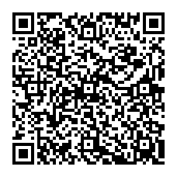
NBME MICROCREDENTIALING SHORT COURSE
Later this year NBME will begin offering free online asynchronous short courses. Be among the first to enroll in our introductory course:
“A Primer for Using Generative Artificial Intelligence in Medical Education.”
Scan the QR code to stay informed and reserve your spot when registration opens!

Slide 82

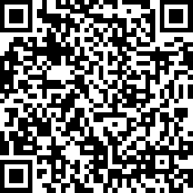
Thank you for joining!
Your feedback is important to us.
https://www.surveymonkey.co.uk/r/LW-4T

